Slide 1
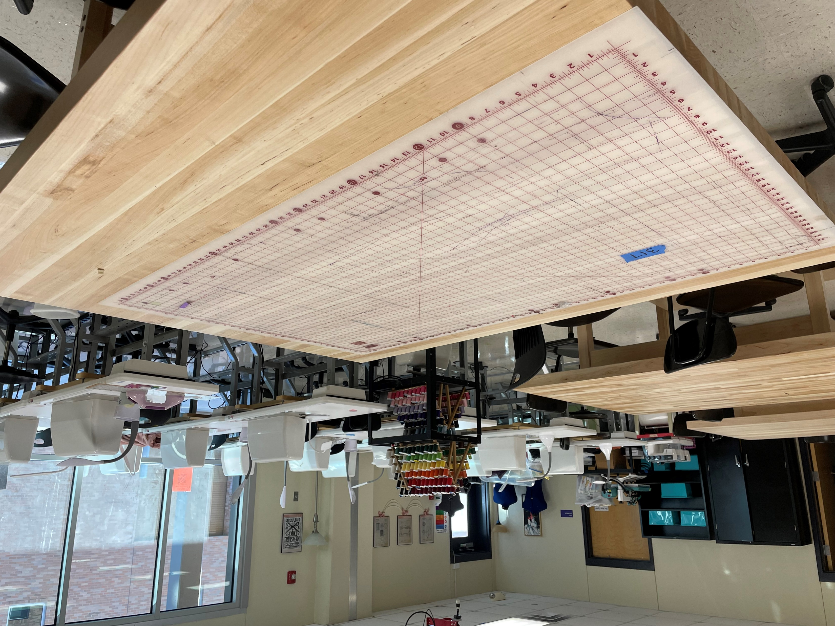
Graphic Design & Multimedia Arts (Fashion Design)
Statewide Program of Study
Arts, Audio/Video Technology, and Communications Career Cluster
The Arts, A/V Technology and Communications (AAVTC) Career Cluster focuses on careers in designing, producing, exhibiting, performing, writing, and publishing multimedia content including visual and performing arts and design, journalism, and entertainment services. Careers in the AAVTC career cluster require a creative aptitude, a strong background in computer and technology applications, a strong academic foundation, and a proficiency in oral and written communication.
The Graphic Design and Multimedia Arts program of study explores the occupations and educational opportunities associated with designing or creating graphics to meet specific commercial or promotional needs, such as packaging, displays, or logos. This program of study may also include exploration into designing clothing and accessories, and creating special effects, animation, or other visual images using film, video, computers, or other electronic tools and media, for use in computer games, movies, music videos, and commercials.
Work-Based Learning and
Expanded Learning Opportunities
Secondary Courses for High School Credit
1 Digital Media
2 Fashion Design I
3 Fashion Design II
4 Career Preparation I
Exploration Activities | Work-Based Learning Activities
Participate in SkillsUSA | Intern with a multimedia or animation studio Obtain a certificate or certification in graphic design
Industry-Based Certifications
Adobe Certified Professional in Graphic Design and Illustration Using Adobe Illustrator
Postsecondary Opportunities
Associates Degrees
Animation, Interactive Technology, Video Graphics and Special Effects
Graphic Design
Game and Interactive Media Design
Bachelor’s Degrees
Animation, Interactive Technology, Video Graphics and Special Effects
Graphic Design
Game and Interactive Media Design
Master’s, Doctoral, and Professional Degrees
Animation, Interactive Technology, Video Graphics and Special Effects
Graphic Design
Intermedia/Multimedia
SMHS Fashion Design Lab
Aligned Occupations
Occupations | Median Wage | Annual Openings | % Growth
Graphic Designers | $44,824 | 1,433 | 15%
Multimedia Artists and Animators | $67,392 | 186 | 21%
Successful completion of the Graphic Design & Multimedia Arts program of study will fulfill requirements of the Business and Industry endorsement. Revised – August 2022

Slide 2
Graphic Design & Multimedia Arts Course Information
COURSE NAME | SERVICE ID | PREREQUISITES | COREQUISITES
Digital Media | 13027800 (1 credit) 6715 | None | None
Fashion Design I | 13009300 (1 credit) 6301 | None | None
Fashion Design II | 13009410 (2 credits) 6760 | Fashion Design I | None
Career Preparation I | 12701300 (2 credits) 6910 | None | None
FOR ADDITIONAL INFORMATION ON THE ARTS, AUDIO/VIDEO TECHNOLOGY, AND COMMUNICATIONS CAREER CLUSTER,
PLEASE CONTACT: CJ Odam, SMCISD CTE Coordinator cj.odam@smcisd.net
San Marcos CISD does not discriminate on the basis of race, color, national origin, sex, disability or age in its programs or activities and provides equal access to the Boy Scouts and other designated youth groups. The following person has been designated to handle inquiries regarding the nondiscrimination policies: Stephanie Munoz ; 631 Mill St, San Marcos, TX 78666 ; 512-393-6700 ; stephanie.munoz@smcisd.net
Further nondiscrimination information can be found at smcisd.net/cte

